Slide 1
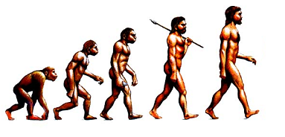
ANTHROPOLOGY
Dr.Anjali Mohan Kodopi
Department of Anthropology
Govt.Digvijay Autonomous P.G. College
Rajnanjgaon C.G

Slide 2
What is Anthropology ? it is the study of human culture and evolutionary aspects of human biology
the study of human beings, especially of their origin, development, customs and beliefs

Slide 3
Anthropology Meaning
Word Anthropology is deriver from Greek language
Anthropos and Logos
Anthropos means Human
Logos means study
Study o Human

Slide 4
DEFINITION OF ANTHROPOLOGY
Anthropology is the study of the origin and development of human societies and cultures. Culture is the learned behavior of people, including their languages, belief systems, social structures, institutions, and material goods.

Slide 5
Major Branches of Anthropology
1- Biological /Physical Anthropology
2- Social Cultural- Anthropology
3-Archaeological Anthropology
4-Linguistic Anthropology

Slide 6
AREA OF STUDY
ARCHAEOLOGY
LINGUISTIC
ANTHROPOLOGY
BIOLOGICAL
ANTHROPOLOGY
CULTURAL
ANTHROPOLOGY
APPLIED
ANTHROPOLOGY

Slide 7
Biological/Physical Anthropology
The study of human biology within the Framework of evolution
Example of Physical Anthropology research:
Science
A body of knowledge gained through observation and experimentation.
Scientific Method
-Science is a process of explaining natural phenomena by means of observation.
-Data is collected that can be studied and analyzed quantitatively.
Scientific Method-Process
-Sate the research problem
- Develop a hypothesis (a provisional explanation)
-Test the hypothesis through data collection and analysis.
-If the hypothesis is verified, it may support a theory.

Slide 8
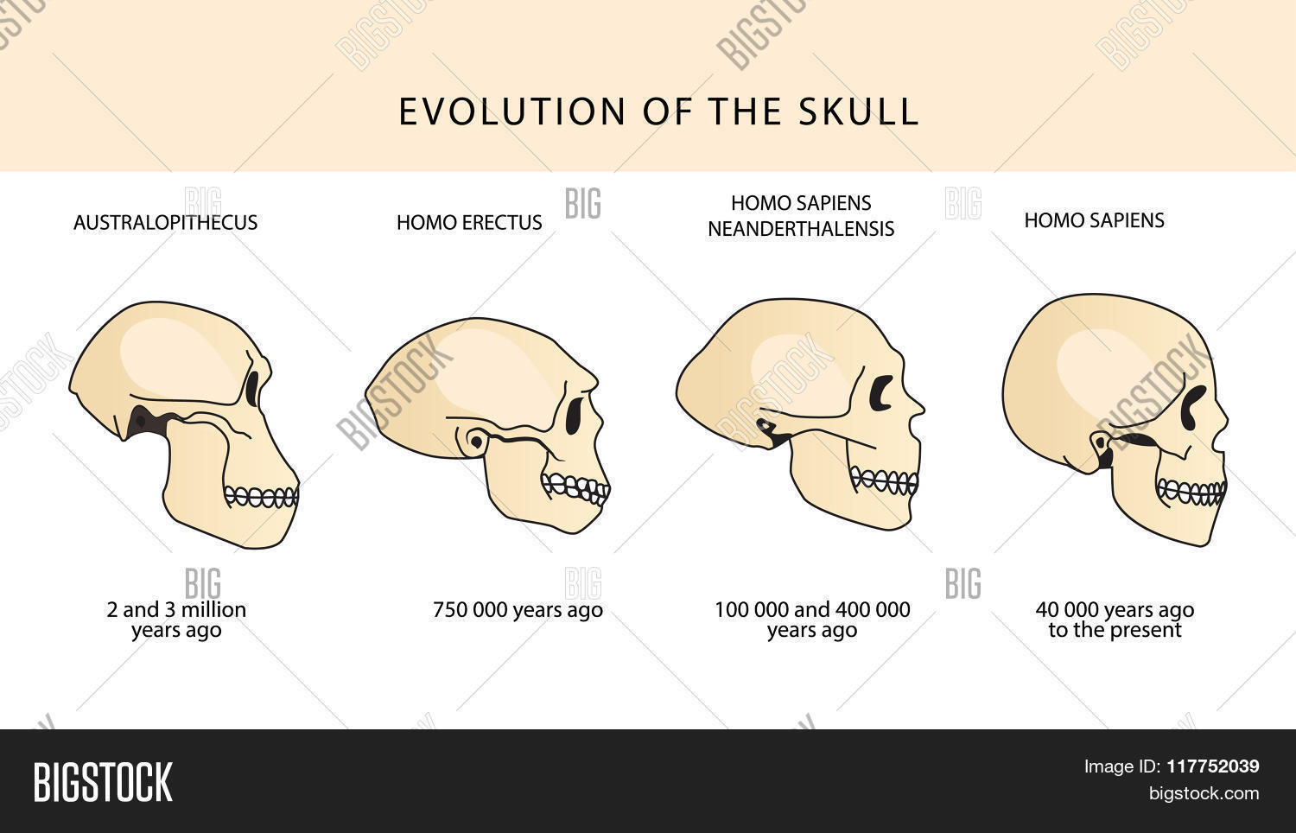

Slide 9
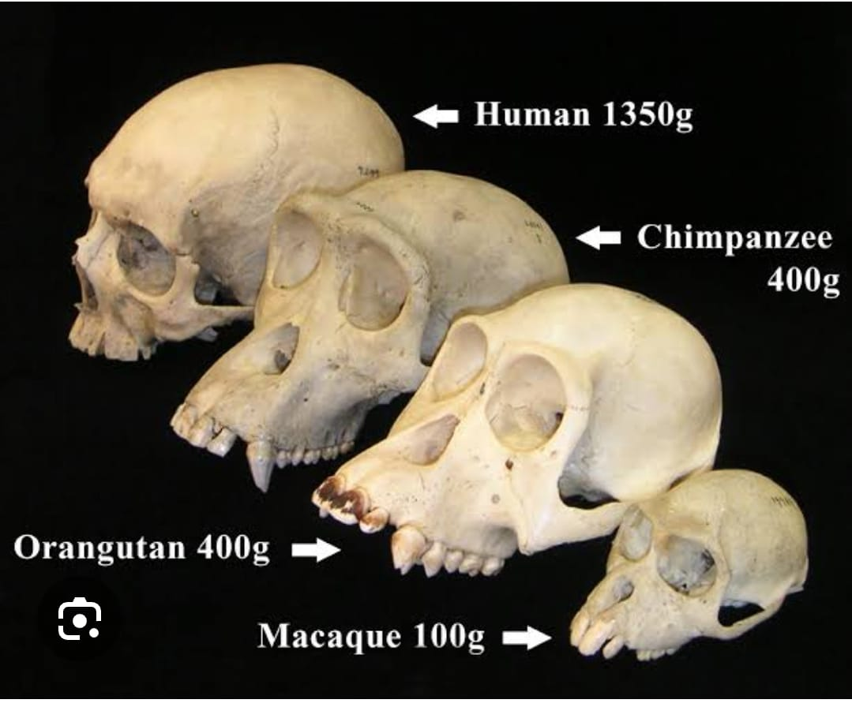

Slide 10
Scientific Method Example
State the research problem
How dose tissue mummify?
Are Certain environments better at causing mummification?
Develop a hypothesis.
I think a wet environment is best for mummification.
Test the hypothesis through data collection and analysis.
Verify the hypothesis
Anthropological Perspective
A broad perspective that help us understand within the context of biological and behavioral continuity with other species.
Why the Anthropological Perspective matters
Anthropology offers a wider appreciation of the human experience in order to understand human beings and how our specie.
Genetics
The study of gene structure and inheritance.

Slide 11
Human Variation
The study of adaptation to environment condition.
Paleoanthropology
The study of human evolution.
Primatology
The study of non- human primates.
Anthropometry
The study of measurements of human body part.
Osteology
The study of the human skeleton.
Paleopathology
The study of disease and injury in skeletal remain.
Forensic Anthropology
The identification of skeletal remain with regard to the law.

Slide 12


Social - Anthropology

Slide 13
Cultural Anthropology
The study of all aspects of human behavior.
Study of the culture of group of society
You have to live in that particular society
Study of patterns of human behavior, thought, and feeling
Cultural is that complex whole which included knowledge
Belief .art, law .morals, custom, and any other capability is and habits acquired by man as a member of society.
Cultural anthropology is the study of human way of life in the broadest possible comparative perspective. Cultural
anthropologists are interested in all type of societies, from hunting and gathering bands to modern industrial states.

Slide 14
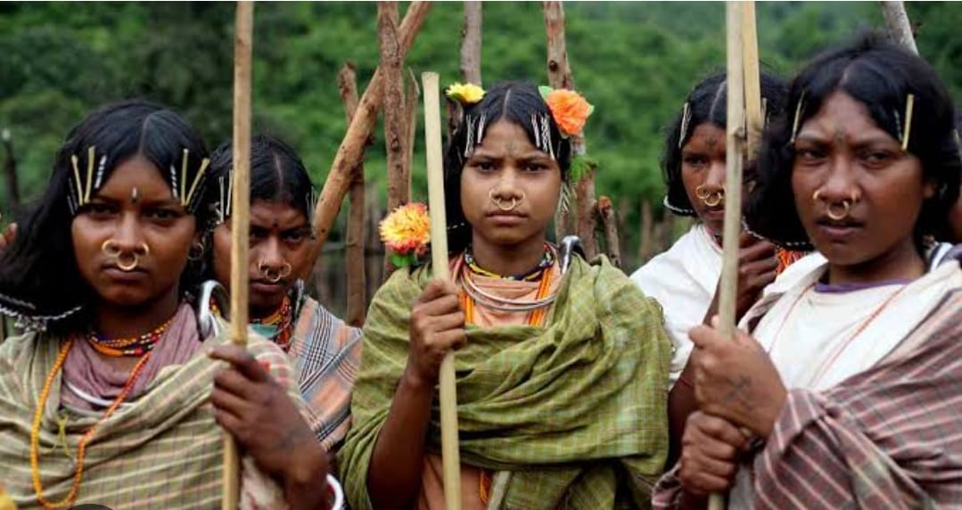
The comparative study of the ways in which people live in different social and culture setting across the globe
Social anthropologists usually report their research in the from of “ethnographies'” which are deltaied descriptions of the society in question
Social anthropology is the study of all people everywhere what they make what they do what the ythink and how they organise their social relationship and societies.

Slide 15
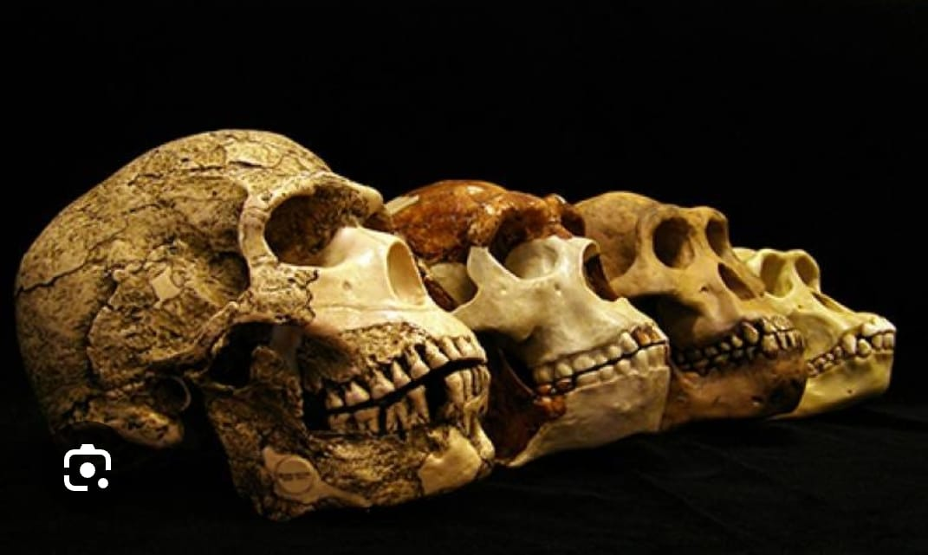
Archaeological Anthropology

Slide 16
Archaeology Anthropology
The study of earlier cultures and ways of life through scientific recovery, analysis and interpretation of material remain.
There are three main branches of study :
Prehistoric archaeology -Culture that do not have writing.
Proto historic archaeology- Culture that have incomplete record.
Historic archaeology- Culture that have well developed historical records.
As, such, these branches of archaeology value different types of data.

Slide 17
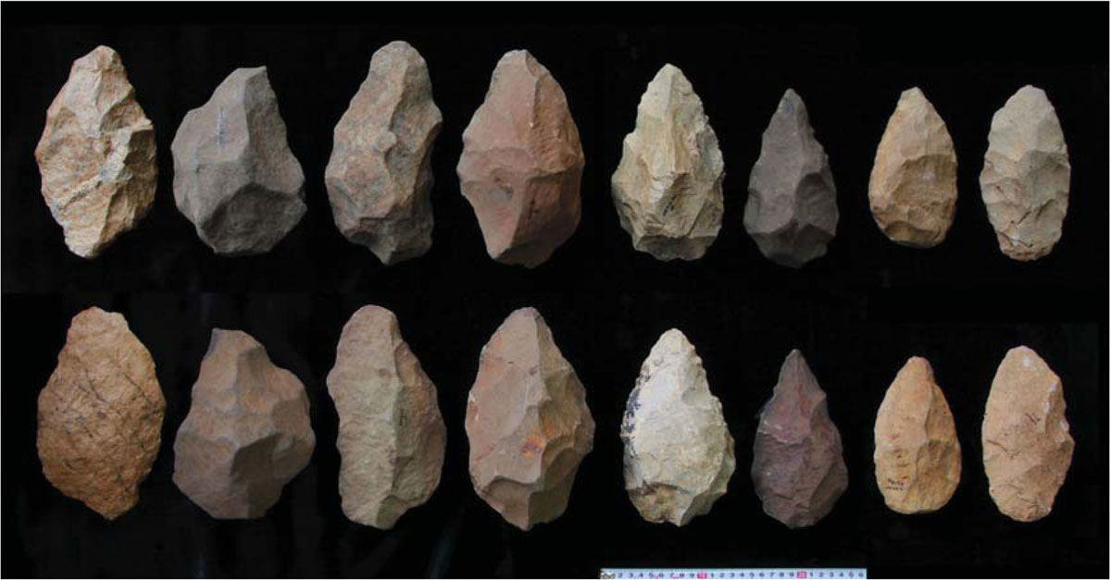

Slide 18
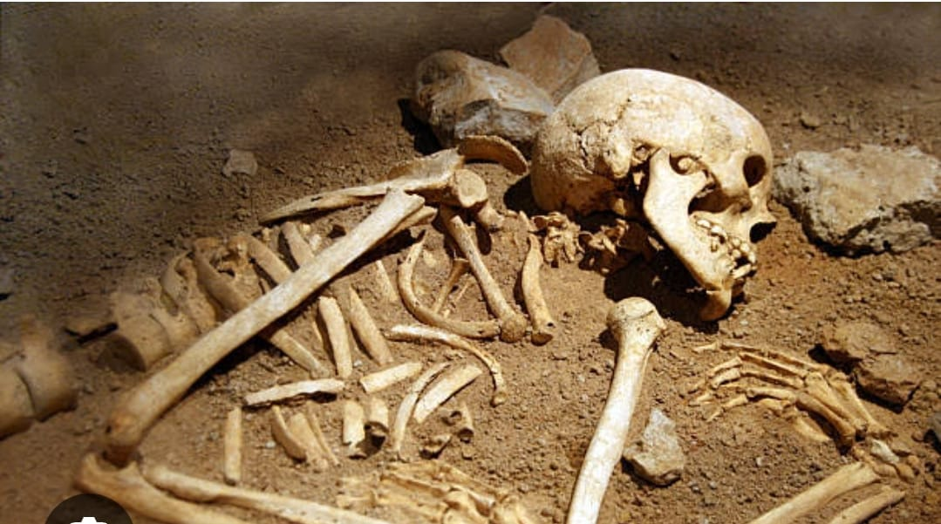

Slide 19
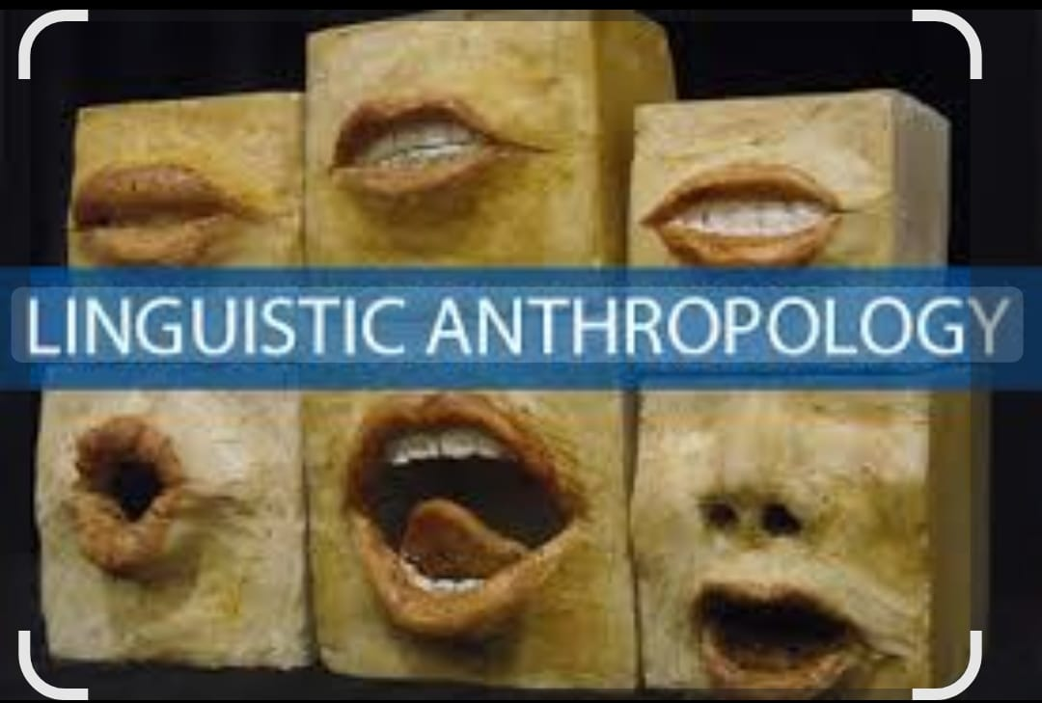

Linguistic Anthropology
LANGUAGE
CULTURE

Slide 20


Slide 21
Linguistic Anthropology
The study of human speech and language .Linguistic anthropology is a branch of anthropology that studies the role of language in the social lives of individual and communities . Linguistic anthropology explores how language shapes
Communication. Language plays a huge role in social identity, group membership and establishing cultural beliefs and ideologies.
Linguistic anthropology is the interdisciplinary study of how language influences social life. it is a branch of anthropology that originated from the endeavour to document endangered languages and has grown over the past century to encompass most aspects of language structure and use.

Slide 22


Slide 23
Thank-You

